Slide 1


LORDS INSTITUTE OF ENGINEERING & TECHNOLOGY
UGC Autonomous Institution, Hyderabad-500091, TS.
Department of Computer Science and Engineering
FINAL YEAR PROJECT
Enterprise AI Search Platform Using Java, Embeddings and Vector Database
Domain: Ai Enabled Full Stack Java
Team Members | CSE-4B2 (Batch No.: 11)
Mohammed Ibrahim – 160923733186
Mohammed Rehan Ahmed – 160923733195
Gulam Minhaj Uddin – 160923733210
Mohammed Rehan Shaik – 160923733222

Slide 2
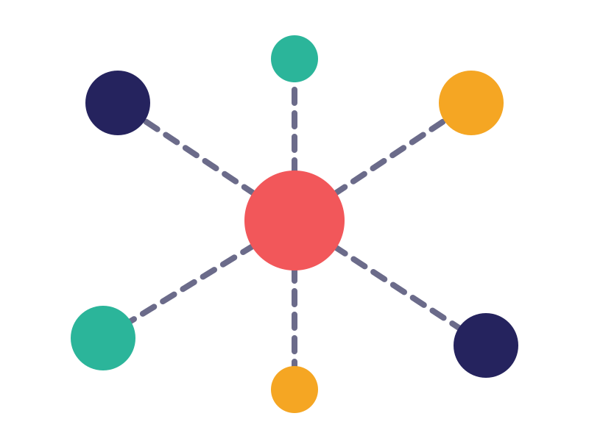
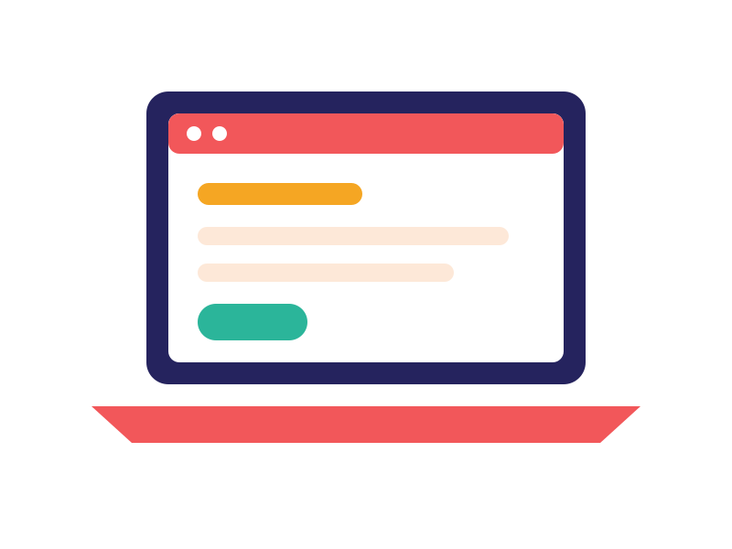
CONTENTS
Presentation Outline
1
Introduction
Abstract, problem statement, objectives
2
Major Modules
Core workflow and 16 modules
3
Technology Stack
Frontend to monitoring
4
Architecture & Demo
Suggested design and demonstration
5
Research & Outlook
Papers, applications, advantages, future scope
Lords Institute of Engineering & Technology | Edge-Cloud Collaborative Web Application Platform
2

Slide 3
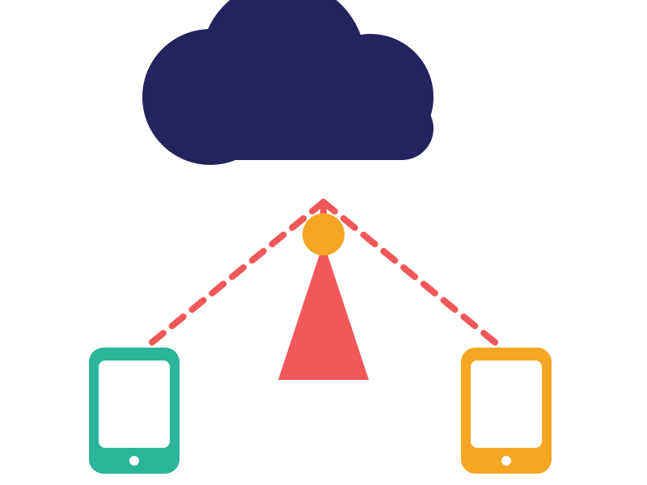




1. INTRODUCTION
Introduction
Distributed web platform combining edge speed with cloud scale
Intelligently decides: process at edge, forward to cloud, or both
Web interface to submit requests, monitor activity and view results
Keeps working at the edge when the cloud is temporarily unreachable
Lords Institute of Engineering & Technology | Edge-Cloud Collaborative Web Application Platform
3

Slide 4
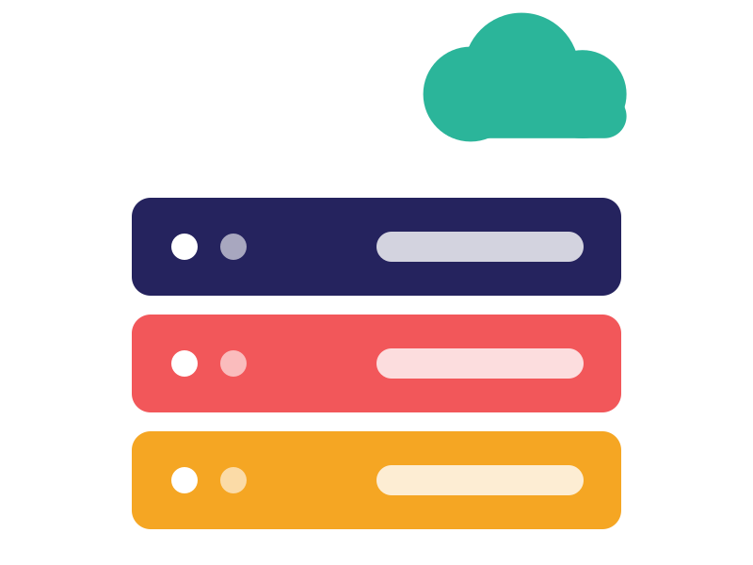
1. INTRODUCTION
Abstract
Overview
A distributed web platform that combines the low-latency processing of edge computing with the scalability, central management and storage of the cloud. Each request is processed at the edge, sent to the cloud, or handled by both.
How it decides
Users submit requests, monitor activity and view results on the web interface. An Edge Gateway/Orchestrator weighs latency needs, workload size, edge resources and network conditions: light, time-sensitive work stays at the edge; heavy compute, analytics and long-term storage go to the cloud.
Capabilities & resilience
Data synchronization, workload offloading, caching, fault handling, monitoring and dynamic resource allocation. If the cloud is unreachable, selected functions keep running at the edge and sync when connectivity returns.
Lords Institute of Engineering & Technology | Edge-Cloud Collaborative Web Application Platform
4

Slide 5
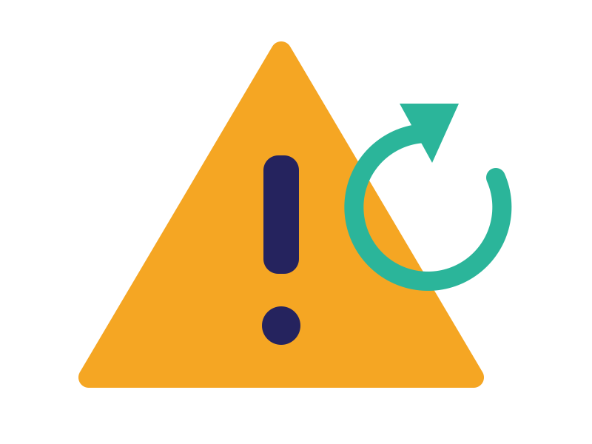



1. INTRODUCTION
Problem Statement
Cloud-only means higher latency
Sending every request to a distant cloud slows time-sensitive web applications.
Edge-only means limited resources
Edge nodes alone cannot handle heavy compute, large analytics or long-term storage.
No intelligent placement
Static routing ignores latency, workload size, edge resources and network conditions.
Connectivity risk
Applications must keep working when the cloud is temporarily unreachable.
Lords Institute of Engineering & Technology | Edge-Cloud Collaborative Web Application Platform
5

Slide 6
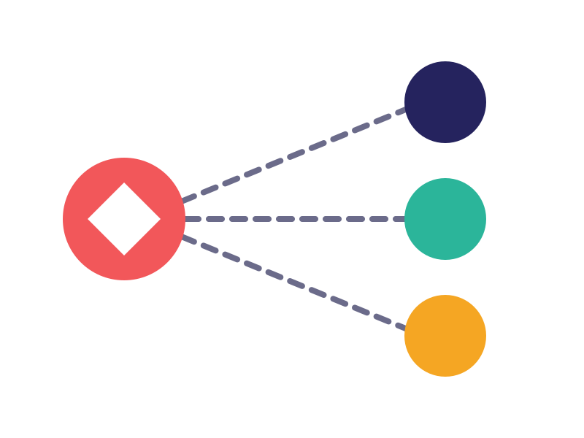



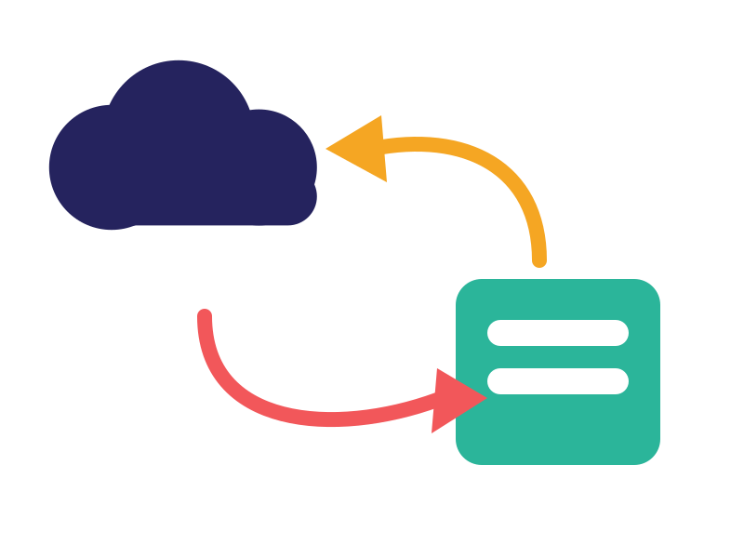

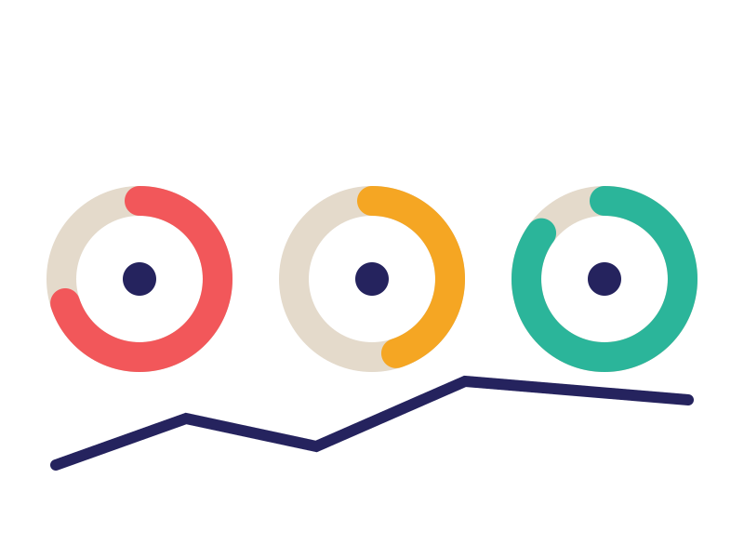
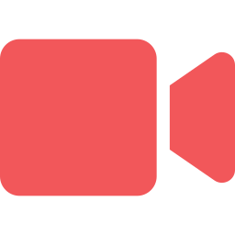
1. INTRODUCTION
Objectives of the Project
01
Design a web platform that runs workloads at the edge, in the cloud, or both
02
Build a decision engine using latency, workload size, resources and network
03
Synchronize edge data with the cloud and keep services running during outages
04
Add monitoring, logging and tracing for full observability
05
Demonstrate the platform with a real-time image/video processing application
Lords Institute of Engineering & Technology | Edge-Cloud Collaborative Web Application Platform
6

Slide 7
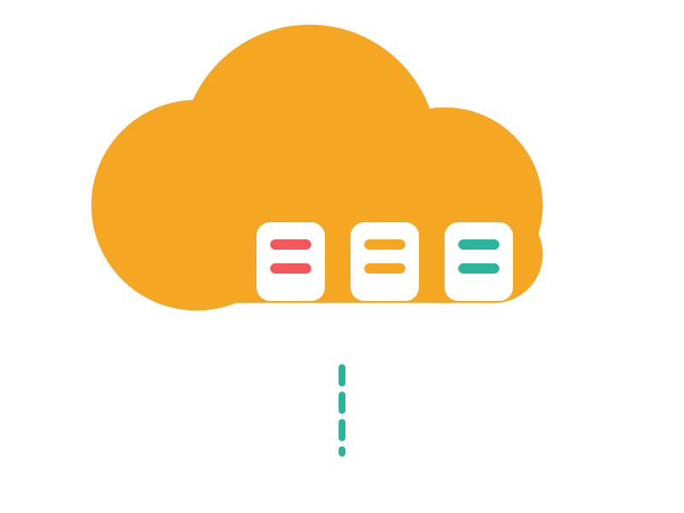


1. INTRODUCTION
Edge vs Cloud
Edge
Cloud
Lightweight, time-sensitive operations
Runs on nearby edge nodes
Fast response, high availability
Continues during network disruptions
VS
Compute-intensive operations
Centralized analytics
Long-term storage
Large-scale, global processing
Lords Institute of Engineering & Technology | Edge-Cloud Collaborative Web Application Platform
7

Slide 8
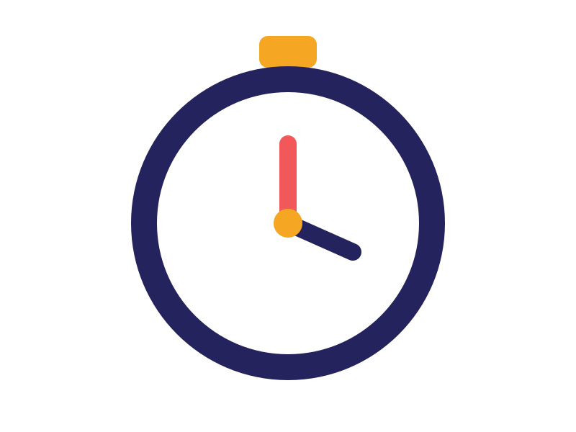


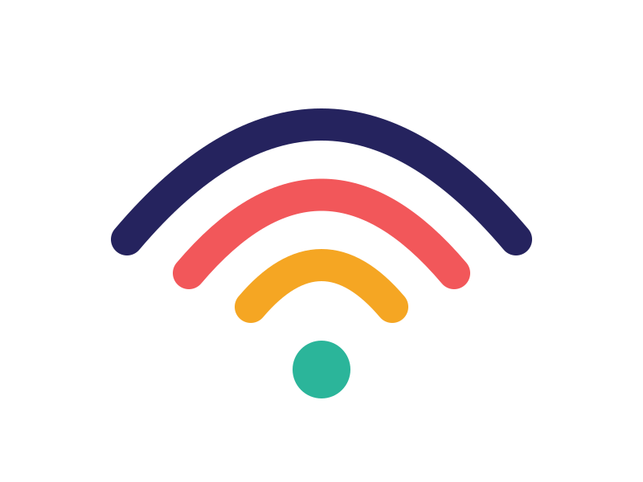
1. INTRODUCTION
How the Platform Decides
Latency requirements
Workload size
Edge resource availability
Network conditions
Process at Edge
Forward to Cloud
Handle Collaboratively
Lords Institute of Engineering & Technology | Edge-Cloud Collaborative Web Application Platform
8

Slide 9



2. MAJOR MODULES
Core Workflow
User / Web App
API Gateway
Edge Gateway /
Decision Engine
Edge Task
Cloud Task
Edge handles latency-sensitive work, the cloud handles heavy compute and storage, and both meet at the synchronizer.
Edge Node Services
Cloud Services
Cloud DB /
Object Storage
Data Synchronizer
Lords Institute of Engineering & Technology | Edge-Cloud Collaborative Web Application Platform
9

Slide 10
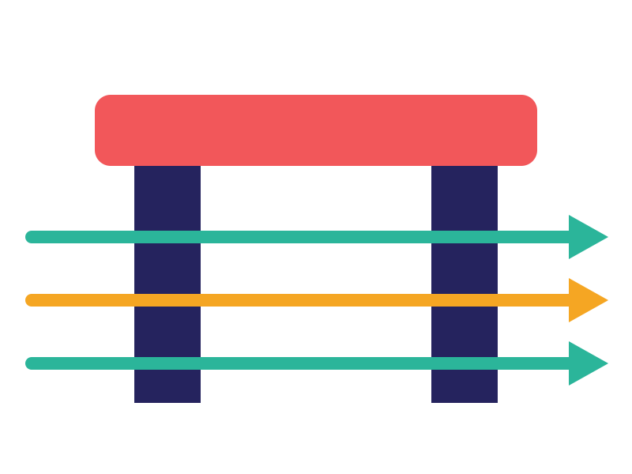

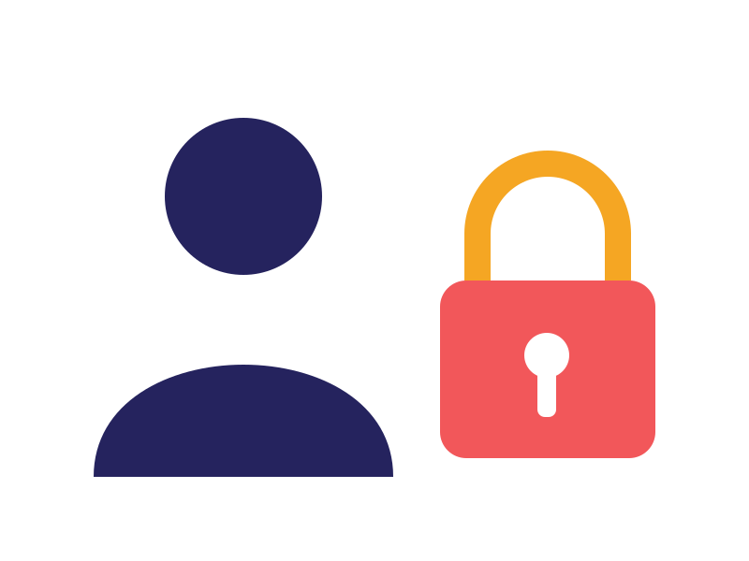
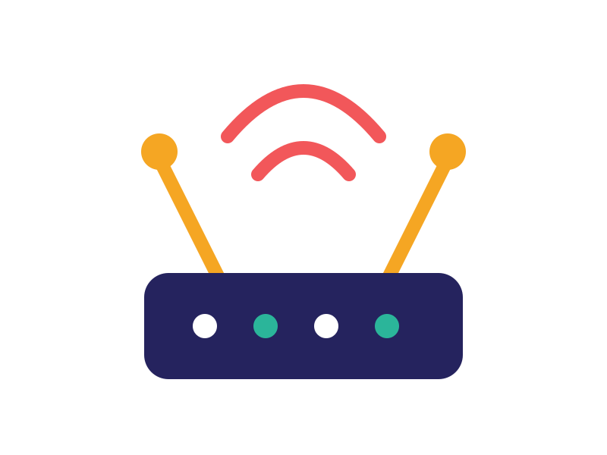
2. MAJOR MODULES · 1–4
Access & Entry
1. User & Authentication
2. Web Application
Registration, login, JWT/OAuth2 authentication, roles and access control.
Browser UI to submit requests, view results, monitor jobs and manage applications.
3. API Gateway
4. Edge Gateway
Single entry point: routing, authentication, rate limiting and request filtering.
Receives requests near the user and decides: process locally or forward to cloud.
Lords Institute of Engineering & Technology | Edge-Cloud Collaborative Web Application Platform
10

Slide 11



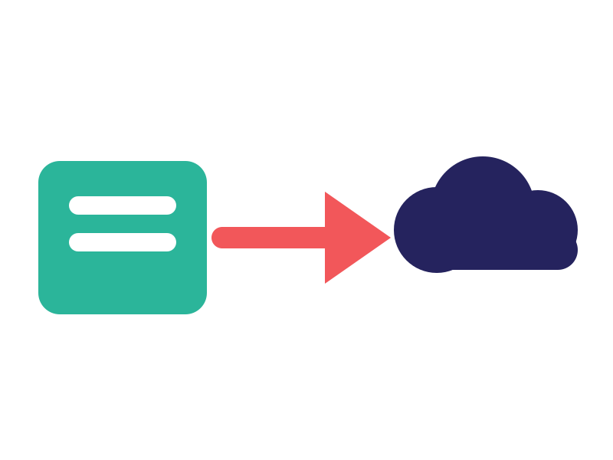
2. MAJOR MODULES · 5–8
Processing & Decisions
5. Edge Service
6. Cloud Service
Runs lightweight application services at edge nodes for low latency.
Centralized services for compute-intensive and large-scale workloads.
7. Workload Decision Engine
8. Task Offloading
Chooses Edge, Cloud or Edge→Cloud using size, latency, resources and connectivity.
Moves workloads from edge to cloud when edge resources are not enough.
Lords Institute of Engineering & Technology | Edge-Cloud Collaborative Web Application Platform
11

Slide 12
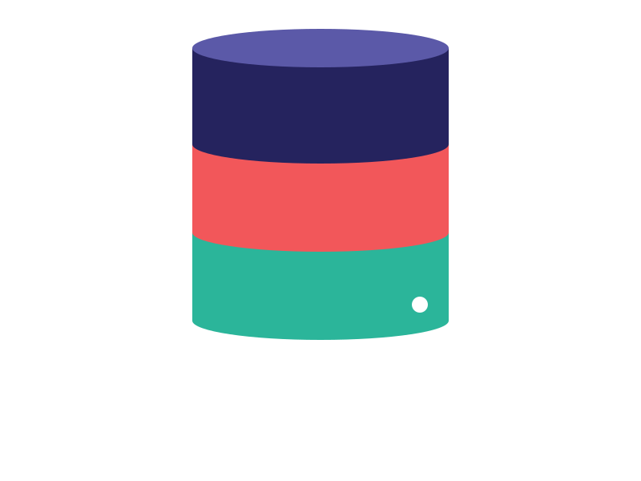

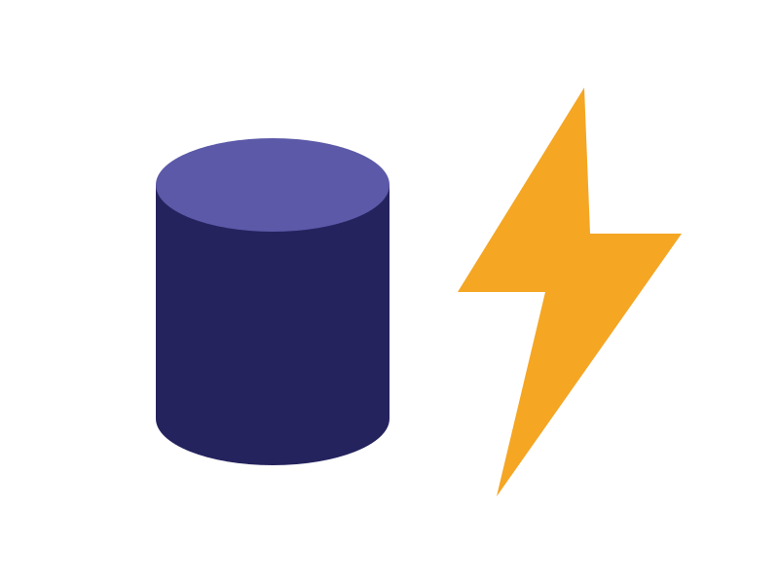


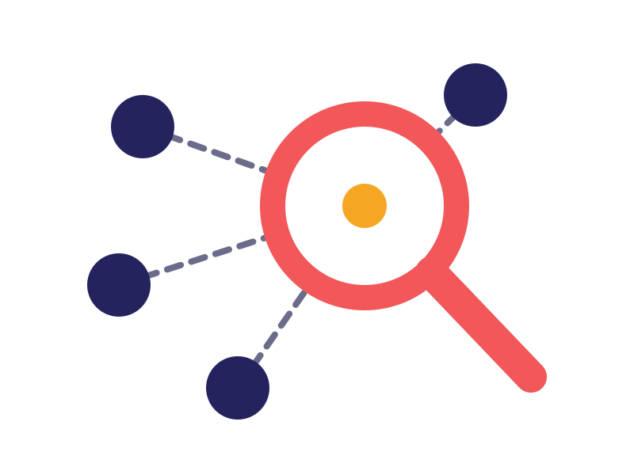
2. MAJOR MODULES · 9–12
Data & Awareness
9. Edge Cache
10. Data Synchronization
Keeps frequent data/results near users to cut response time and cloud calls.
Syncs edge data to the cloud and handles delayed sync after reconnection.
11. Resource Monitoring
12. Service Discovery
Tracks CPU, memory, disk, latency, request rate, container health.
Lets edge and cloud services find available instances dynamically.
Lords Institute of Engineering & Technology | Edge-Cloud Collaborative Web Application Platform
12
Notes:
[Syed Saud Ali] The third group is data and awareness. Module nine, Edge Cache, keeps frequently used data close to users, which reduces response time and cloud calls. Module ten, Data Synchronization, sends edge data to the cloud and handles delayed sync after reconnection. Module eleven, Resource Monitoring, tracks CPU, memory, disk, latency, request rate and container health. Module twelve, Service Discovery, lets edge and cloud services find available instances dynamically.

Slide 13

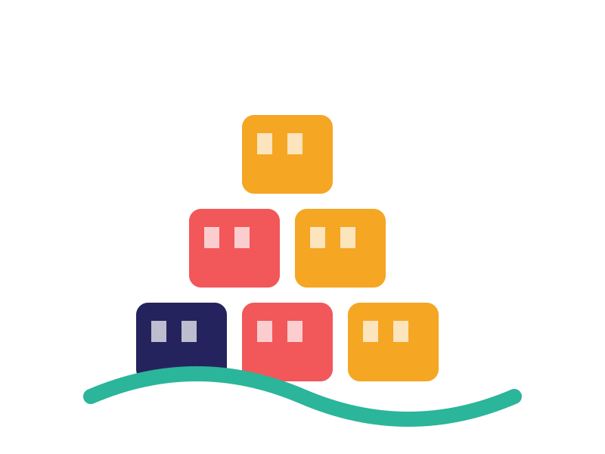


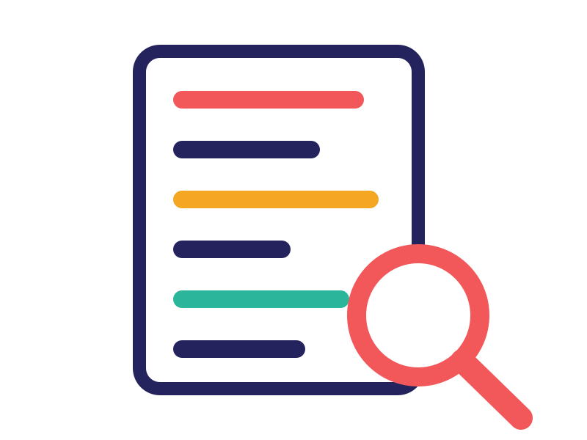
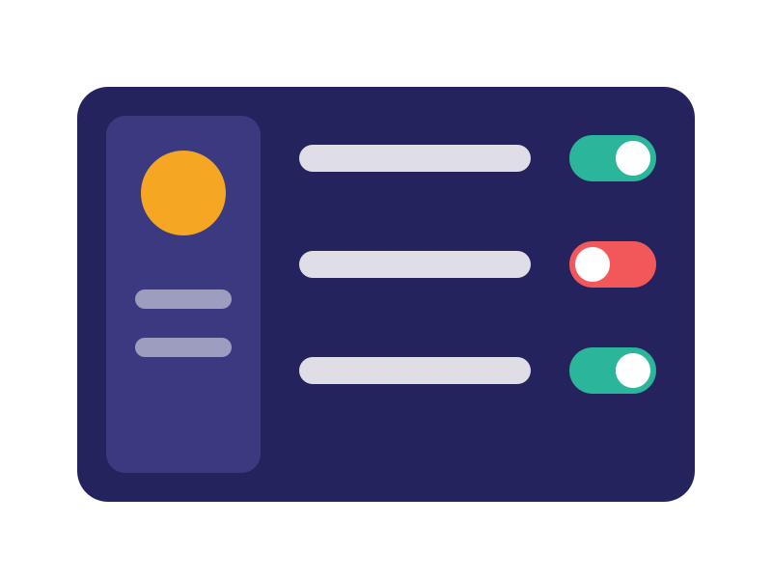
2. MAJOR MODULES · 13–16
Reliability & Operations
13. Fault Tolerance
14. Container Management
Handles node failure, cloud outage, timeout, retry, fallback and recovery.
Packages components as containers and manages deployment across edge and cloud.
15. Logging & Observability
16. Administration Dashboard
Centralized logs, metrics, traces, latency, failures and health dashboards.
Admin view of edge nodes, cloud services, workloads, users and performance.
Lords Institute of Engineering & Technology | Edge-Cloud Collaborative Web Application Platform
13

Slide 14


3. TECHNOLOGY STACK
Frontend & Backend
Frontend
Backend
React.js / TypeScript
HTML5
CSS3
Bootstrap / Material UI
Axios
React Router
Chart.js / Recharts for monitoring dashboards
Java 21
Spring Boot 3.x
Spring Web / REST
Spring Security
JWT / OAuth2
Spring Data JPA
Hibernate
Spring Cloud Gateway
Spring Cloud OpenFeign
Resilience4j
Lords Institute of Engineering & Technology | Edge-Cloud Collaborative Web Application Platform
14

Slide 15

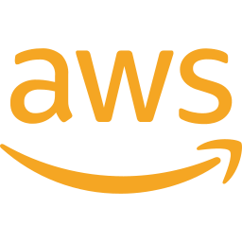


3. TECHNOLOGY STACK
Edge & Cloud Layers
Edge Layer
Cloud Layer (choose one)
Docker
Docker Compose
Kubernetes / K3s
NGINX
MQTT for IoT/edge
REST APIs
WebSocket for real-time updates
AWS
Azure
Google Cloud
EC2
ECS/EKS
S3
RDS
CloudWatch
Lambda
AKS
Container Apps
Blob Storage
Azure Database
Azure Monitor
GKE
Cloud Run
Cloud Storage
Cloud SQL
Cloud Monitoring
K3s: lightweight Kubernetes, ideal for edge nodes
Lords Institute of Engineering & Technology | Edge-Cloud Collaborative Web Application Platform
15

Slide 16

3. TECHNOLOGY STACK
Database & Messaging
Database
Messaging & Sync
Primary: PostgreSQL / MySQL
Optional: MongoDB for high-volume, event-oriented data
Optional: Redis for caching
Apache Kafka
RabbitMQ
MQTT
Redis Streams
Kafka suits reliable, asynchronous Edge → Cloud synchronization.
Lords Institute of Engineering & Technology | Edge-Cloud Collaborative Web Application Platform
16

Slide 17
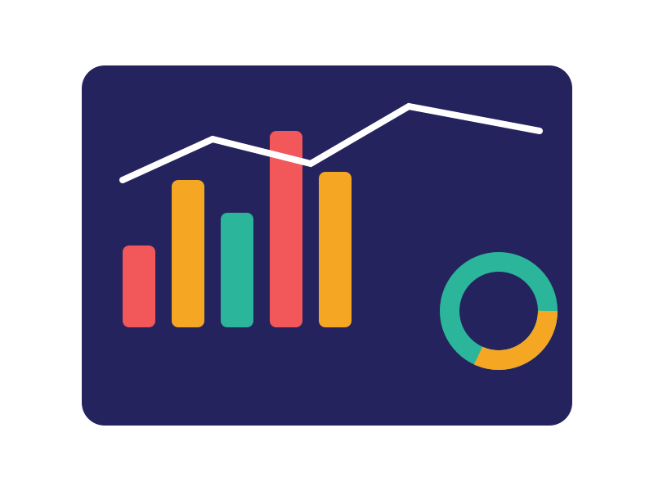


3. TECHNOLOGY STACK
DevOps & Monitoring
DevOps
Monitoring
Git
GitHub
Maven
Docker
Kubernetes / K3s
Helm
Jenkins / GitHub Actions
Terraform
Prometheus
Grafana
ELK Stack
OpenTelemetry
Jaeger
Loki
Lords Institute of Engineering & Technology | Edge-Cloud Collaborative Web Application Platform
17

Slide 18
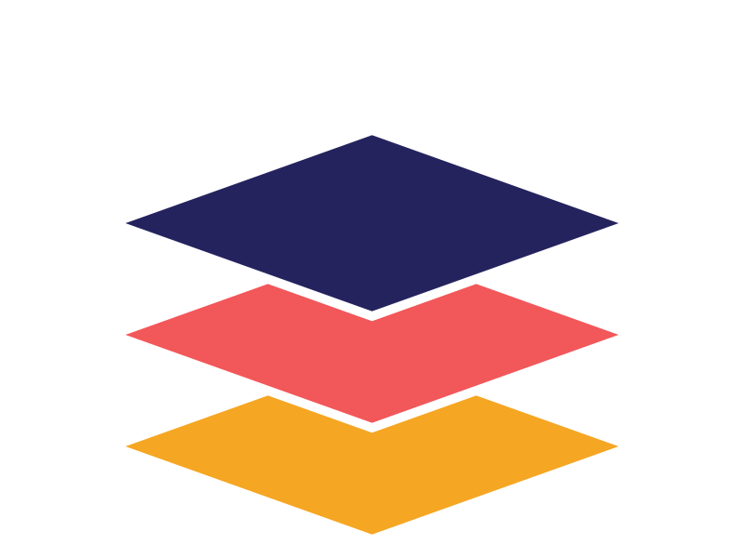
4. ARCHITECTURE
Suggested Final-Year Architecture
Layer | Technology
UI | React + TypeScript
API Gateway | Spring Cloud Gateway
Backend | Spring Boot + Java 21
Authentication | Spring Security + JWT
Edge | Docker + K3s
Cloud | AWS / Azure
Database | PostgreSQL
Cache | Redis
Messaging | Kafka
Layer | Technology
Service Communication | REST + OpenFeign
Resilience | Resilience4j
Containerization | Docker
Orchestration | Kubernetes/K3s
Monitoring | Prometheus + Grafana
Logging | ELK / Loki
Tracing | OpenTelemetry + Jaeger
CI/CD | GitHub Actions / Jenkins
Infrastructure | Terraform
Key contribution: dynamic workload placement and edge-cloud collaboration, cutting latency while keeping cloud scalability.
Lords Institute of Engineering & Technology | Edge-Cloud Collaborative Web Application Platform
18
Notes:
[Taha Hussain] This table summarizes the complete architecture layer by layer: React for the UI, Spring Cloud Gateway as the API gateway, Spring Boot on Java 21 for the backend, Spring Security with JWT for authentication, Docker with K3s at the edge, AWS or Azure in the cloud, PostgreSQL, Redis, Kafka, Resilience4j, Prometheus with Grafana, ELK or Loki, OpenTelemetry with Jaeger, GitHub Actions or Jenkins, and Terraform. The key contribution is dynamic workload placement and edge-cloud collaboration, which reduces latency while keeping cloud scalability. It is not just a Spring Boot application hosted in the cloud.

Slide 19

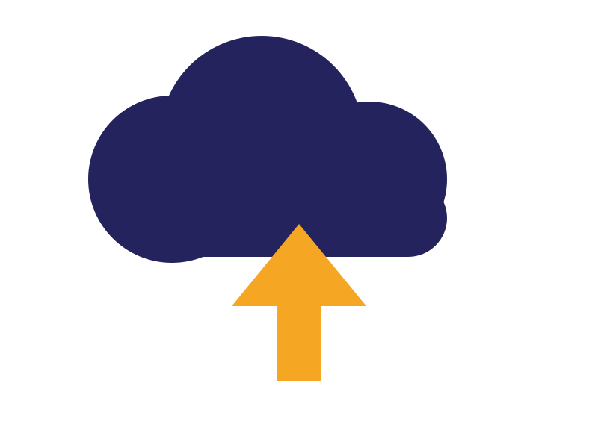





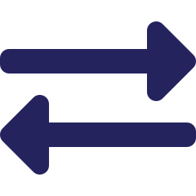


4. DEMONSTRATION
Real-Time Image/Video Processing Demo
1
2
3
4
User uploads an image/video
Request reaches the nearest Edge Gateway
Small / latency-sensitive work goes to Edge
Large / compute-intensive work goes to Cloud
5
6
7
8
Edge caches frequently requested results
Kafka syncs important events/data with the cloud
If cloud fails, selected functions continue at edge
Grafana shows Edge vs Cloud latency, CPU, request count, failures, workload distribution
Lords Institute of Engineering & Technology | Edge-Cloud Collaborative Web Application Platform
19
Notes:
[Taha Hussain] Our demonstration scenario is a real-time image and video processing web application. Step one, the user uploads an image or video. Step two, the request reaches the nearest Edge Gateway. Step three, small or latency-sensitive work is done at the edge. Step four, large or compute-intensive work goes to the cloud. Step five, the edge caches frequently requested results. Step six, Kafka syncs important events and data with the cloud. Step seven, if the cloud fails, selected functions continue at the edge. Step eight, Grafana shows edge versus cloud latency, CPU, request count, failures and workload distribution. Now Mohammed Arfan will continue.

Slide 20






5. RESEARCH & OUTLOOK
Applications
Real-time video analytics
Smart cities
Healthcare monitoring
Frames processed at the edge, deep analysis in the cloud.
Traffic and sensor data handled near the source.
Fast local alerts with cloud-based record analysis.
Industrial IoT
Gaming & AR/VR
Retail & content delivery
Local control loops with cloud analytics.
Low-latency interaction close to the player.
Popular content cached near users for quick access.
Lords Institute of Engineering & Technology | Edge-Cloud Collaborative Web Application Platform
20

Slide 21

5. RESEARCH & OUTLOOK
Related Research Papers
[1] L. Bedogni and F. Chiariotti, “A Web of Things approach for learning on the Edge–Cloud Continuum,” Future Gener. Comput. Syst., vol. 171, art. 107855, 2025.
EDGE-CLOUD LEARNING: digital twins cut edge load; sim-to-real gap and sync overhead remain open.
[2] J. Liu, Y. Du, K. Yang, et al., “Edge-Cloud Collaborative Computing on Distributed Intelligence and Model Optimization: A Survey,” arXiv:2505.01821, 2025.
ECCC SURVEY: collaboration, model optimization and resource-management challenges.
[3] W. Shi, J. Cao, Q. Zhang, Y. Li and L. Xu, “Edge Computing: Vision and Challenges,” IEEE Internet of Things J., vol. 3, no. 5, 2016.
EDGE: process data near its source to cut response time and bandwidth.
[4] M. Satyanarayanan, “The Emergence of Edge Computing,” Computer (IEEE), vol. 50, no. 1, 2017.
EDGE + CLOUD: edge complements the cloud for latency-sensitive apps.
[5] Y. Mao, C. You, J. Zhang, K. Huang and K. B. Letaief, “A Survey on Mobile Edge Computing: The Communication Perspective,” IEEE Commun. Surveys & Tutorials, vol. 19, no. 4, 2017.
OFFLOADING: offloading and resource management behind our decision engine.
[6] A. Haas et al., “Bringing the Web up to Speed with WebAssembly,” ACM SIGPLAN PLDI, 2017.
WEBASSEMBLY: a fast, safe, portable binary format for the web.
[7] B. H. Sigelman et al., “Dapper, a Large-Scale Distributed Systems Tracing Infrastructure,” Google Technical Report, 2010.
OBSERVABILITY: distributed tracing, basis of our OpenTelemetry/Jaeger stack.
Lords Institute of Engineering & Technology | Edge-Cloud Collaborative Web Application Platform
21

Slide 22
5. RESEARCH & OUTLOOK
Literature Review & Research Gaps
Paper | Method | Focus | Limitation | Gap Identified
Bedogni & Chiariotti (2025) “A Web of Things approach for learning on the Edge–Cloud Continuum” (Univ. of Padua) | Web of Things framework; DRL agents trained offline in digital twins | Learning on the edge–cloud continuum | Depends heavily on offline training in digital twins; twins refined at the edge are uploaded to the cloud | Sim-to-real (reality) gap largely ignored; model synchronization overhead
Liu et al. (2025) “Edge-Cloud Collaborative Computing on Distributed Intelligence and Model Optimization: A Survey” | Survey of edge-cloud collaborative computing | Distributed intelligence and model optimization | Needs high processing power, memory and energy (esp. IoT); LLMs add pressure; diverse hardware, OS, bandwidth and protocols | Network connectivity and low-latency needs (autonomous, industrial, healthcare); eventual consistency and resource isolation barriers
Our Work | Edge-cloud web platform with a Decision Engine | Dynamic edge / cloud placement for web apps | Rule-based engine today; AI-driven placement is future work | Latency-aware placement, Kafka sync (eventual consistency), fault tolerance, containers for mixed hardware, full observability
Research gap we target: intelligent, latency-aware placement with reliable sync, fault tolerance and observability
Lords Institute of Engineering & Technology | Edge-Cloud Collaborative Web Application Platform
22

Slide 23

5. RESEARCH & OUTLOOK
Advantages of the Platform
Low latency
Scalability
Time-sensitive work is served at nearby edge nodes.
Heavy compute and storage scale in the cloud.
Resilience
Faster responses
Selected functions keep running if the cloud is unreachable.
Edge cache cuts repeat calls to the cloud.
Full observability
Efficient resources
Logs, metrics and traces show health end to end.
Dynamic allocation places work where it fits best.
Lords Institute of Engineering & Technology | Edge-Cloud Collaborative Web Application Platform
23

Slide 24
5. RESEARCH & OUTLOOK
Future Improvements
WebAssembly Workloads
AI-Driven Placement
01
02
Package services as Wasm modules for fast startup and one portable build for edge and cloud.
Learn from past latency and load to predict the best edge or cloud placement.
Multi-Edge & Multi-Cloud
Stronger Security
03
04
Federate several edge sites and cloud providers with automatic failover.
Add zero-trust access, encrypted sync and device attestation.
Autoscaling & Serverless
Smarter Observability
05
06
Scale edge and cloud functions up and down with demand.
Use anomaly detection on metrics and traces for proactive alerts.
Lords Institute of Engineering & Technology | Edge-Cloud Collaborative Web Application Platform
24

Slide 25

5. RESEARCH & OUTLOOK
Conclusion
What we built
How it works
What it delivers
An edge-cloud collaborative web platform that sends each request to the edge, the cloud, or both.
A decision engine weighs latency, workload size, edge resources and network conditions, backed by sync, caching and fault tolerance.
Low latency, cloud scalability and continued service during outages, with monitoring and tracing throughout.
Edge speed + cloud scale = a smarter, more resilient web platform
Lords Institute of Engineering & Technology | Edge-Cloud Collaborative Web Application Platform
25

Slide 26
Thank You
Edge-Cloud Collaborative Web Application Platform
Mohammed Ibrahim | Mohammed Rehan |Gulam MInhaj | Mohammed Rehan
CSE-4B2 (Batch No.: 11)
Notes:
[Mohammed Arfan] Thank you, everyone, for your attention. We are Mohd. Mohiuddin, Syed Saud Ali, Taha Hussain and Mohammed Arfan from CSE-4B1, Batch 06. We would be happy to answer your questions.

